Slide 1



DISSERTATION - 1
Question Answer Based Interactive Storytelling Using Generative AI
Generating meaningful narratives through structured Q&A inputs
Number: 124MTCM1008
M-Tech Final year project
Semister : III
Anjali Madan Jha
Guided by: Dr.Vidyullata Devmane
Computer Engineering

Slide 2
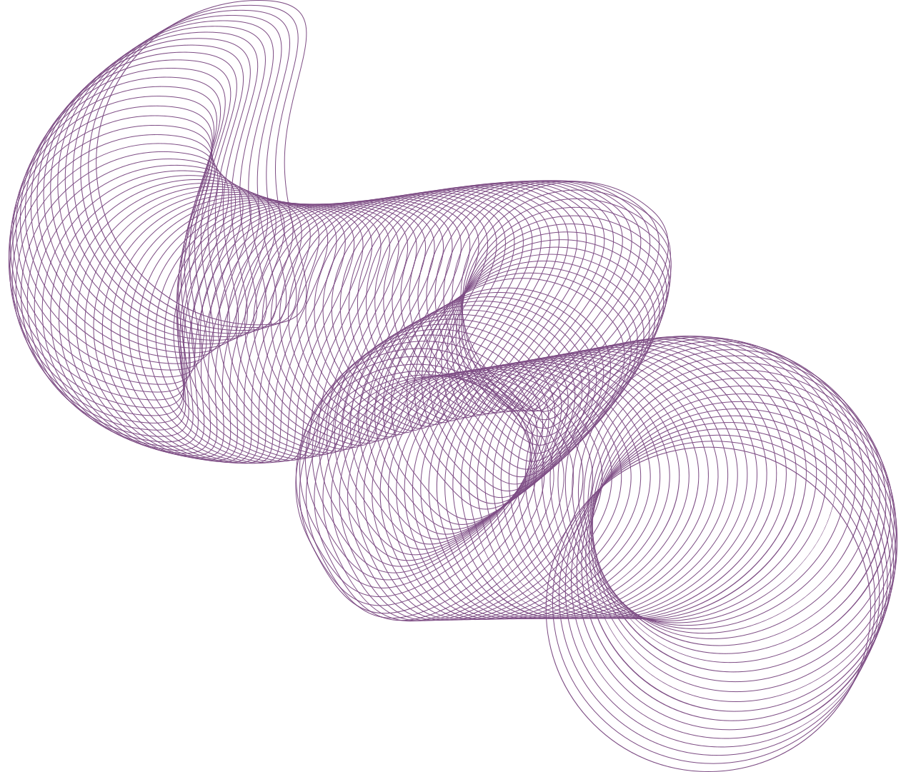


Contents
01
Introduction
06
Block Diagram
02
Motivation
07
Implementation
03
Literature Survey
08
Results and Analysis
04
Gaps, Objectives and Scope
09
Conclusion
05
Problem Statement
10
References

Slide 3



Question–answer–based story generation is an emerging field in Generative AI that focuses on transforming user-driven inputs into coherent, contextually rich narratives. With advancements in Large Language Models (LLMs), machines can now understand natural language queries, capture user intent, and generate personalized stories that feel meaningful and human-like. This project explores how LLMs can be leveraged to build an automated system that converts structured or unstructured questions and answers into creative, dynamic stories.
The growing demand for interactive storytelling in education, entertainment, gaming, and digital content has highlighted the need for intelligent systems that adapt to user inputs. By integrating LLMs with a guided question–answer framework, this project aims to enhance user engagement and ensure story coherence, creativity, and relevance. The objective is to design a robust, scalable model capable of generating high-quality narratives based on user-provided responses.
introduction
introduction

Slide 4




Motivation
Addresses Unexplored Research Gap: Literature review of 30+ papers reveals no existing work on Q&A-driven narrative generation, presenting a novel research opportunity.
Enables User-Driven Story Creation: Structured questioning framework allows users to actively shape narratives through conversational interaction rather than passive prompting.
Technical Innovation: Integrates adaptive question generation, context-aware dialogue management, and LLM-based narrative synthesis into unified framework.
Broad Application Potential: Proposed system has applications across education, interactive entertainment, therapeutic storytelling, and content creation domains.

Slide 5
Literature Review
Sr | Year | Authors | Title | Venue | Idea Summary | Method / Tech Used | Research Gap (for your Q&A story project) | Link
1 | 2024 | R. Farrell et al. | LLMs as Narrative Planning Search Guides | IEEE Transactions on Games | Uses LLMs to guide the creation of coherent textual narrative sequences. | GPT-based heuristic search | No Q&A interaction, no personalized story shaping. | PDF: https://cs.uky.edu/~sgware/reading/papers/farrell2024large.pdf
2 | 2023 | Y. Huang et al. | Guided Story Generation with External Knowledge | IEEE Access | Generates text stories using structured knowledge graphs + LLM. | GPT-2/3 + knowledge integration | Doesn’t take Q&A input; limited personalization. | https://ieeexplore.ieee.org/document/10090973
3 | 2023 | G. Tambwekar et al. | Controllable Neural Story Generation | IEEE Transactions on Games | Controls style, theme, and emotion in generated stories. | Reinforced LSTM + LLM | Not interactive; lacks user-driven Q&A shaping. | https://ieeexplore.ieee.org/document/10021351
4 | 2023 | K. Li et al. | Plot-Guided Story Generation via Prompting | IEEE Access | Uses prompts and templates to steer LLM story outputs. | Prompt engineering for GPT-3 | No dynamic question-answering component. | https://ieeexplore.ieee.org/document/10289342
5 | 2022 | S. Ammanabrolu et al. | Hierarchical Neural Story Generation | IEEE Transactions on Games | Generates multi-paragraph stories with plot control. | Hierarchical Transformer | No interactive Q&A branching. | https://ieeexplore.ieee.org/document/9783130

Slide 6
Literature Review
Sr | Year | Authors | Title | Venue | Idea Summary | Method / Tech Used | Research Gap (for your Q&A story project) | Link
6 | 2022 | M. Mao et al. | Character-centric Story Generation | IEEE Access | Focuses on character consistency in long stories. | Transformer decoder | No mechanism for user-driven Q&A personalization. | https://ieeexplore.ieee.org/document/9712325
7 | 2024 | R. Zhang et al. | Prompt-Driven Narrative Generation Using LLMs | IEEE Access | Improves coherence by structuring user prompts → controlled text stories. | Instruction-tuned LLM | No Q&A pipeline; only single-shot prompts. | https://ieeexplore.ieee.org/document/10527305
8 | 2023 | M. Peng et al. | Interactive Story Generation with Dialogue Inputs | IEEE Access | Text story generation using dialogue turns (closest to Q&A). | BART / GPT dialogue → story converter | Does not explicitly structure Q&A → story pipeline. | https://ieeexplore.ieee.org/document/10045611
9 | 2022 | J. Li et al. | Long-Form Story Generation with Discourse Planning | IEEE Access | Ensures story coherence using discourse-aware planning. | Discourse Planner + LLM | Still not user-personalized; no Q&A involvement. | https://ieeexplore.ieee.org/document/9724244
10 | 2024 | H. Wu et al. | Evaluation of AI-Generated Narratives | IEEE Access | Analyzes story quality generated by LLMs. | LLM-based story metrics | Not a generation model but useful for evaluation. | https://ieeexplore.ieee.org/document/10453284

Slide 7




Research Gap
Personalization
Coherence
Control
Evaluation
Current story-generation models cannot convert user Q&A inputs into highly personalized narrative elements.
LLMs struggle to maintain consistent plot, characters, and themes across multi-step Q&A interactions.
Existing systems lack mechanisms for users to control story flow, genre, or structure through guided questions.
There is no standard framework to evaluate Q&A-based interactive stories for quality, relevance, and engagement.

Slide 8
Research Objectives
Structured Input Design
Personalized Story Generation
Narrative Coherence Control
Story Quality Evaluation

Slide 9
Scope
EN
6
1
2-6
Language
Genres
Users
Story length
Stories are generated in English
Fantasy, science fiction, mystery, romance, thriller and adventure
One user per session, answering 4, 8, 12 or 17 questions
Two to six chapters of 250 to 400 words each
Model: Llama 3.2 3B, fine-tuned for this system, running locally on a laptop with 8 GB of memory
Outside the scope: video generation, several users writing one story together, and languages other than English.

Slide 10
problem statement
problem statement
Despite major progress in generative AI and large language models, current story-generation systems are still mostly prompt based and do not use structured question and answer inputs to build meaningful narratives. Existing models are unable to convert step by step user responses into coherent, personalized and context rich stories. They often lose narrative consistency in plot, characters and emotional flow when multiple user inputs are involved, which results in generic or fragmented storytelling. There is also no clear framework that allows users to control the story’s theme, tone, genre or direction through an interactive question and answer process. These limitations show the need for an intelligent system that can capture user responses in real time and generate high quality personalized stories with strong coherence, better control and improved narrative alignment.

Slide 11





Proposed System
Context Extraction Engine
Output Delivery & Integration
User Input Acquisition
LLM-Based Story Generator

Slide 12
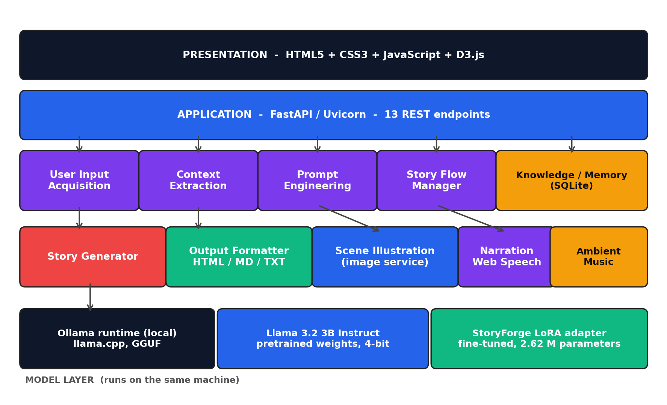
Block Diagram
1
Presentation
Single-page web interface: questions, story, images, Story Map, Character Graph
2
Application
FastAPI server with 13 REST endpoints and session handling
3
Modular core
Seven modules: input, context, memory, prompts, generator, story flow, formatter
4
Multimodal
Scene illustration, narration and genre-matched ambient music
5
Model layer
Fine-tuned Llama 3.2 3B (LoRA adapter) on the local Ollama runtime

Slide 13
Implementation: Processing Pipeline
From the user's answers to a finished multimodal chapter
01
02
03
04
05
06
07
Q&A Elicitation
Context Extraction
Knowledge & Memory
Prompt Engineering
Llama Generation
Story Flow
Output & Media
17 questions in 4 dimensions; budgets of 4, 8, 12 or 17
Answers mapped to a typed StoryContext
SQLite store; last two segments as context
Phase-aware templates plus user-added preferences
Fine-tuned Llama 3.2, running locally
Five-phase state machine; continuity and pacing checks
Formatted text, scene image, narration, music
Five-phase story progression (driven by word count)
Introduction
0–400 words
Rising Action
400–1,200
Climax
1,200–1,800
Falling Action
1,800–2,400
Resolution
2,400+ words
Custom answers and user-added questions reach the model prompt through a dedicated custom_elements channel, so the question set can grow without any change to code or database schema.

Slide 14
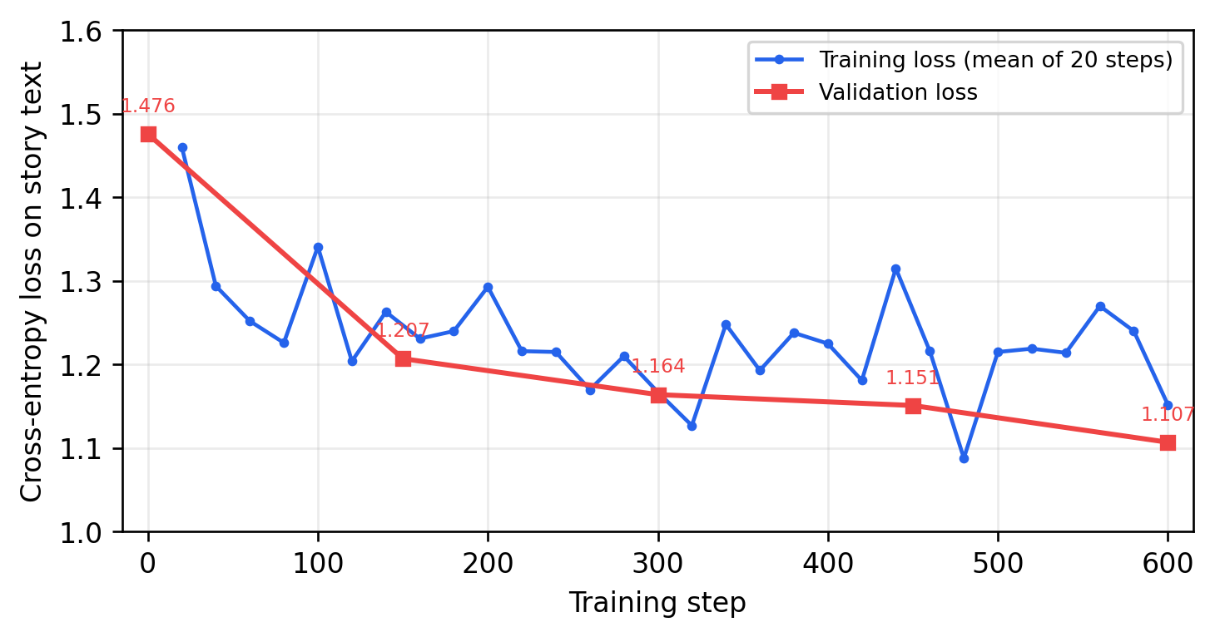
Implementation: Fine-Tuning the Llama Model
01
Dataset
1,000 public stories turned into 3,321 training samples in the system's own prompt format
02
QLoRA training
Llama 3.2 3B, rank 16; 2.62 million of 3.21 billion parameters trained (0.082%)
03
Training run
600 steps in about one hour on an Apple M2 laptop with 8 GB of memory
Validation loss fell from 1.476 to 1.107 over 600 steps
Deployment
3,321
0.082%
about 1 h
04
10 MB adapter loaded on the pretrained weights in the local Ollama runtime
training samples
of weights trained
training time

Slide 15
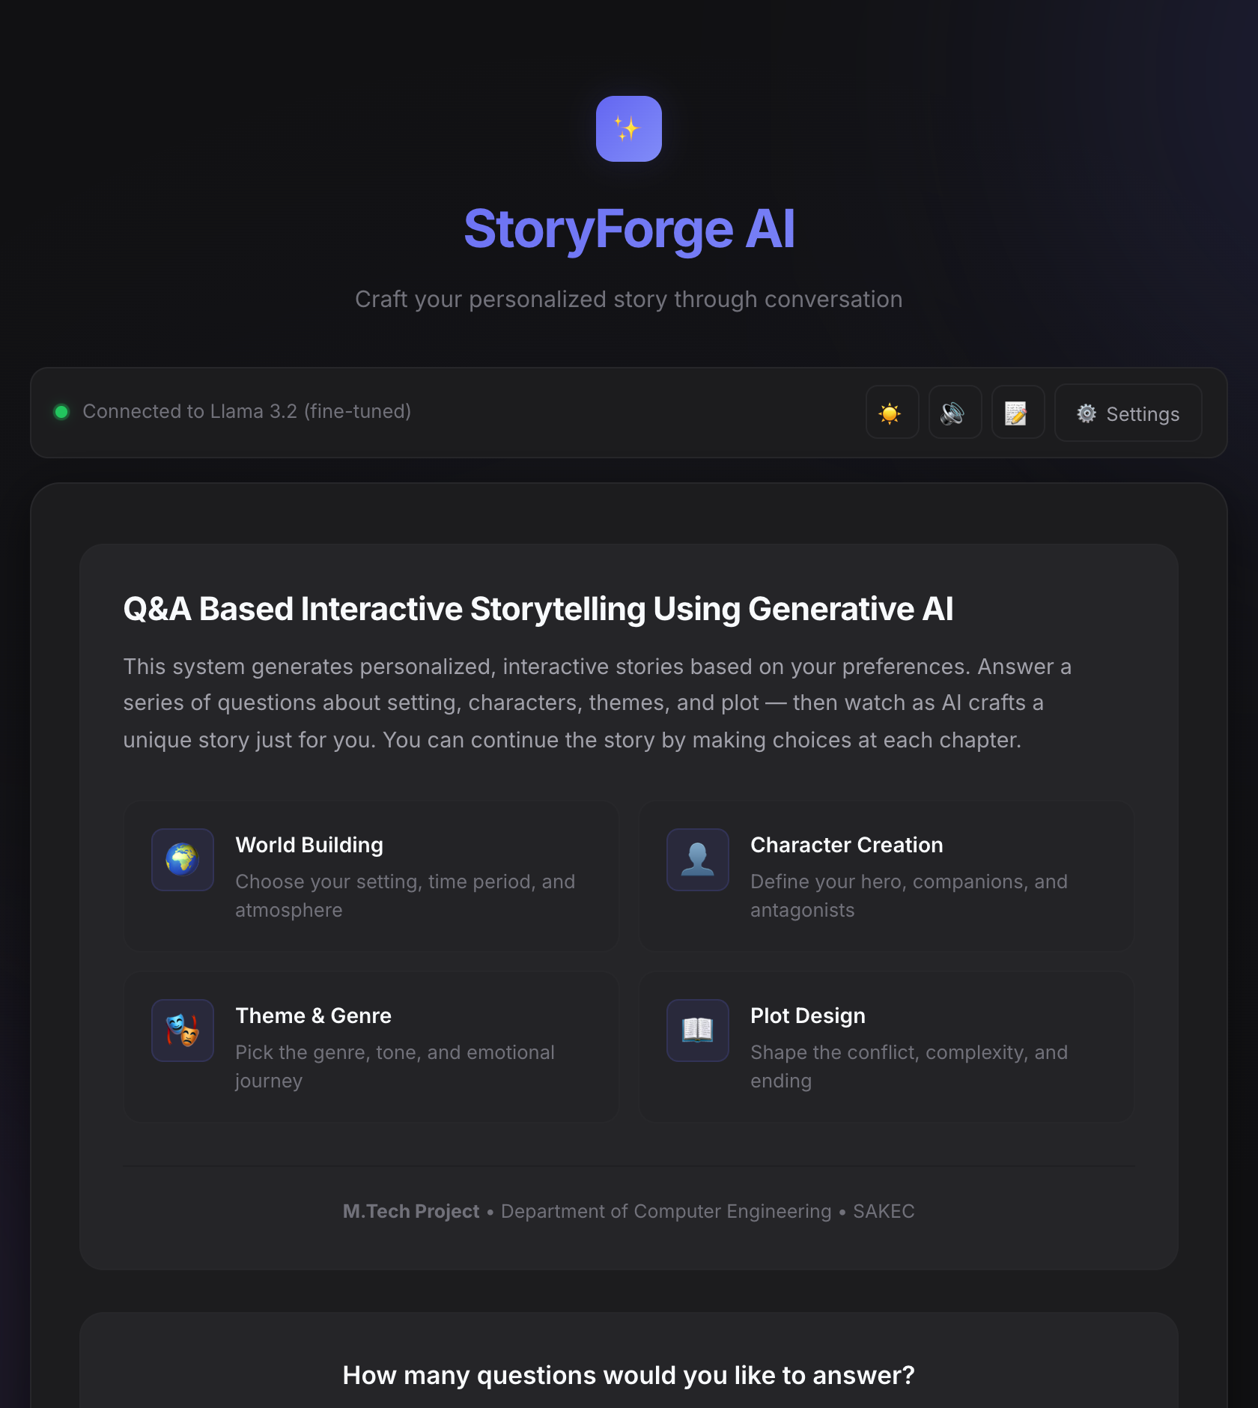
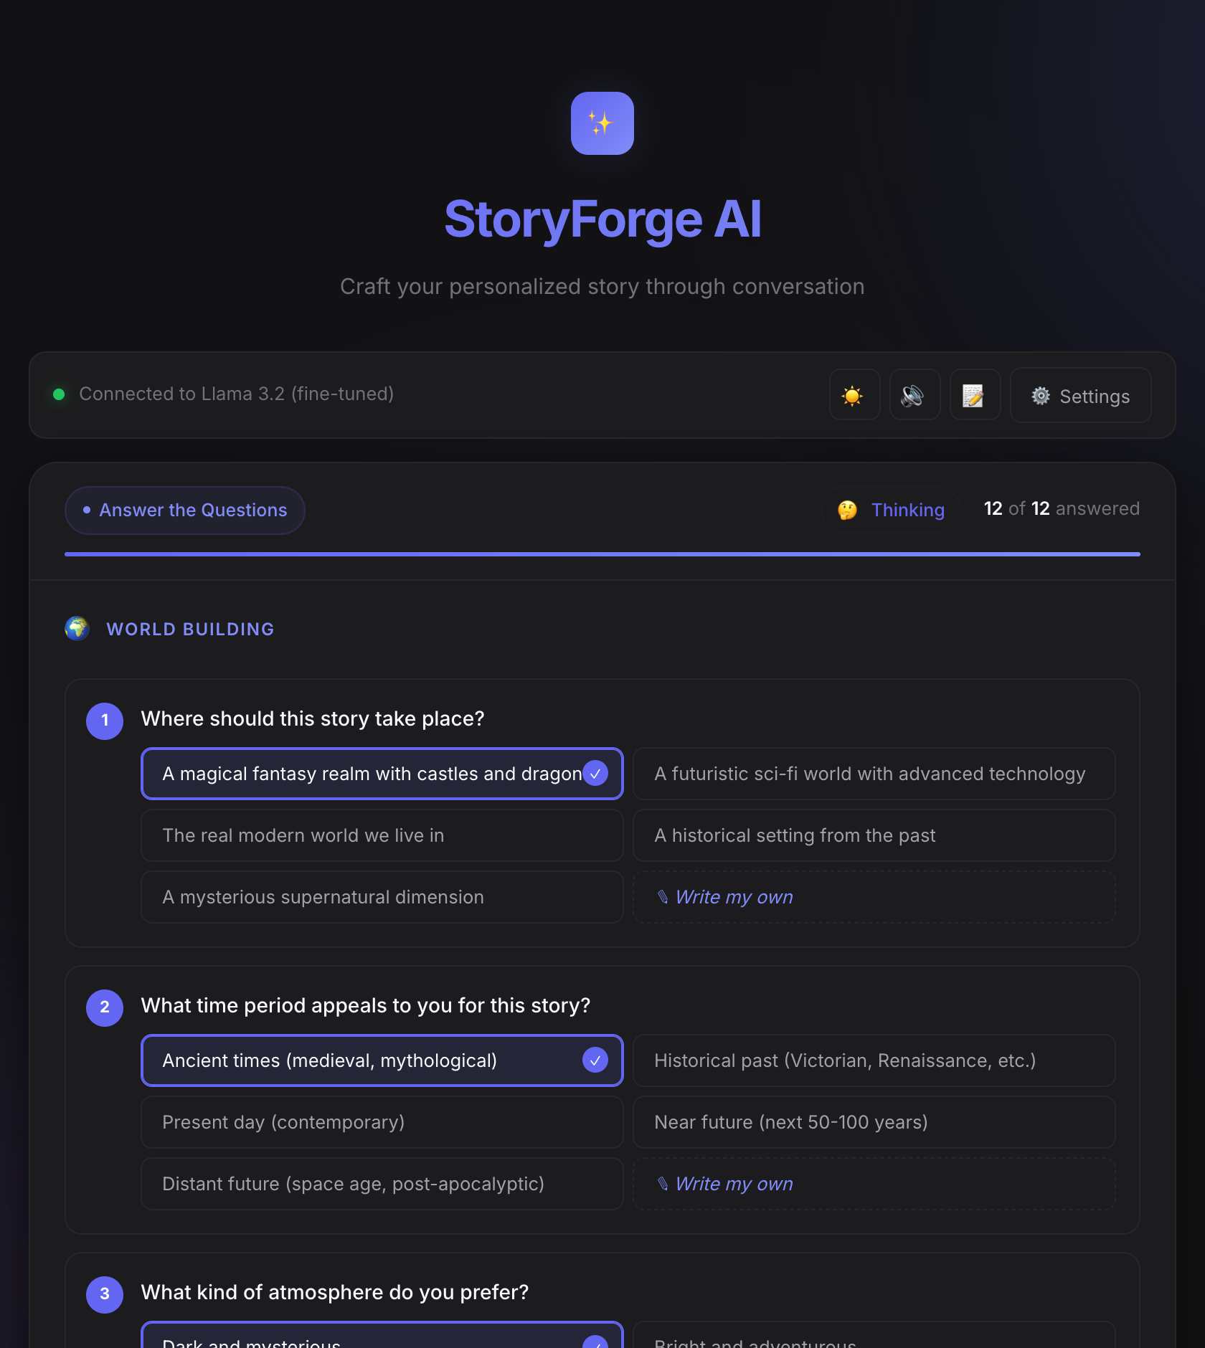
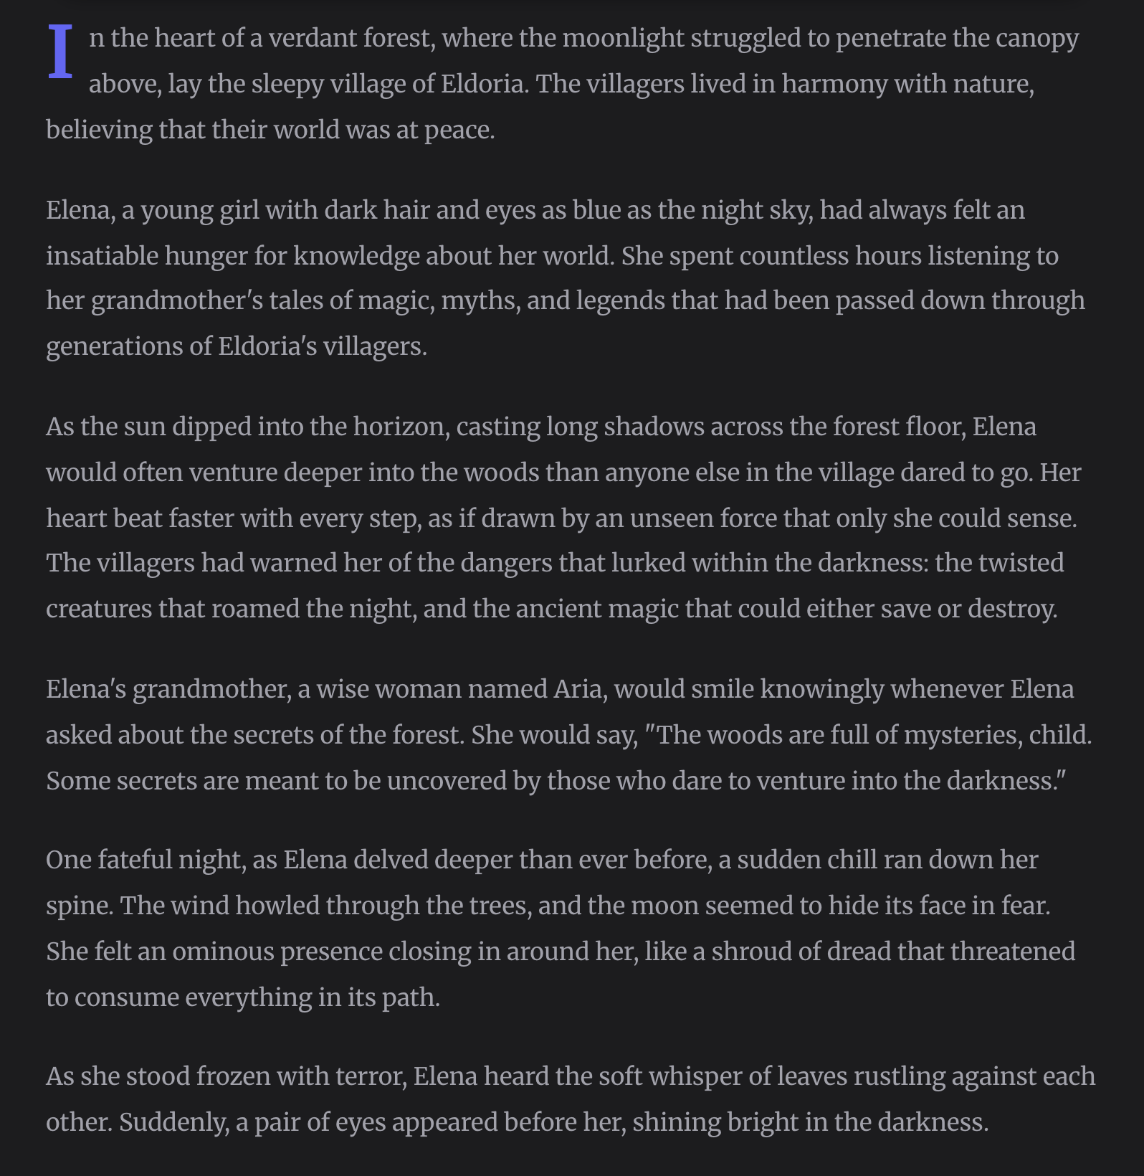
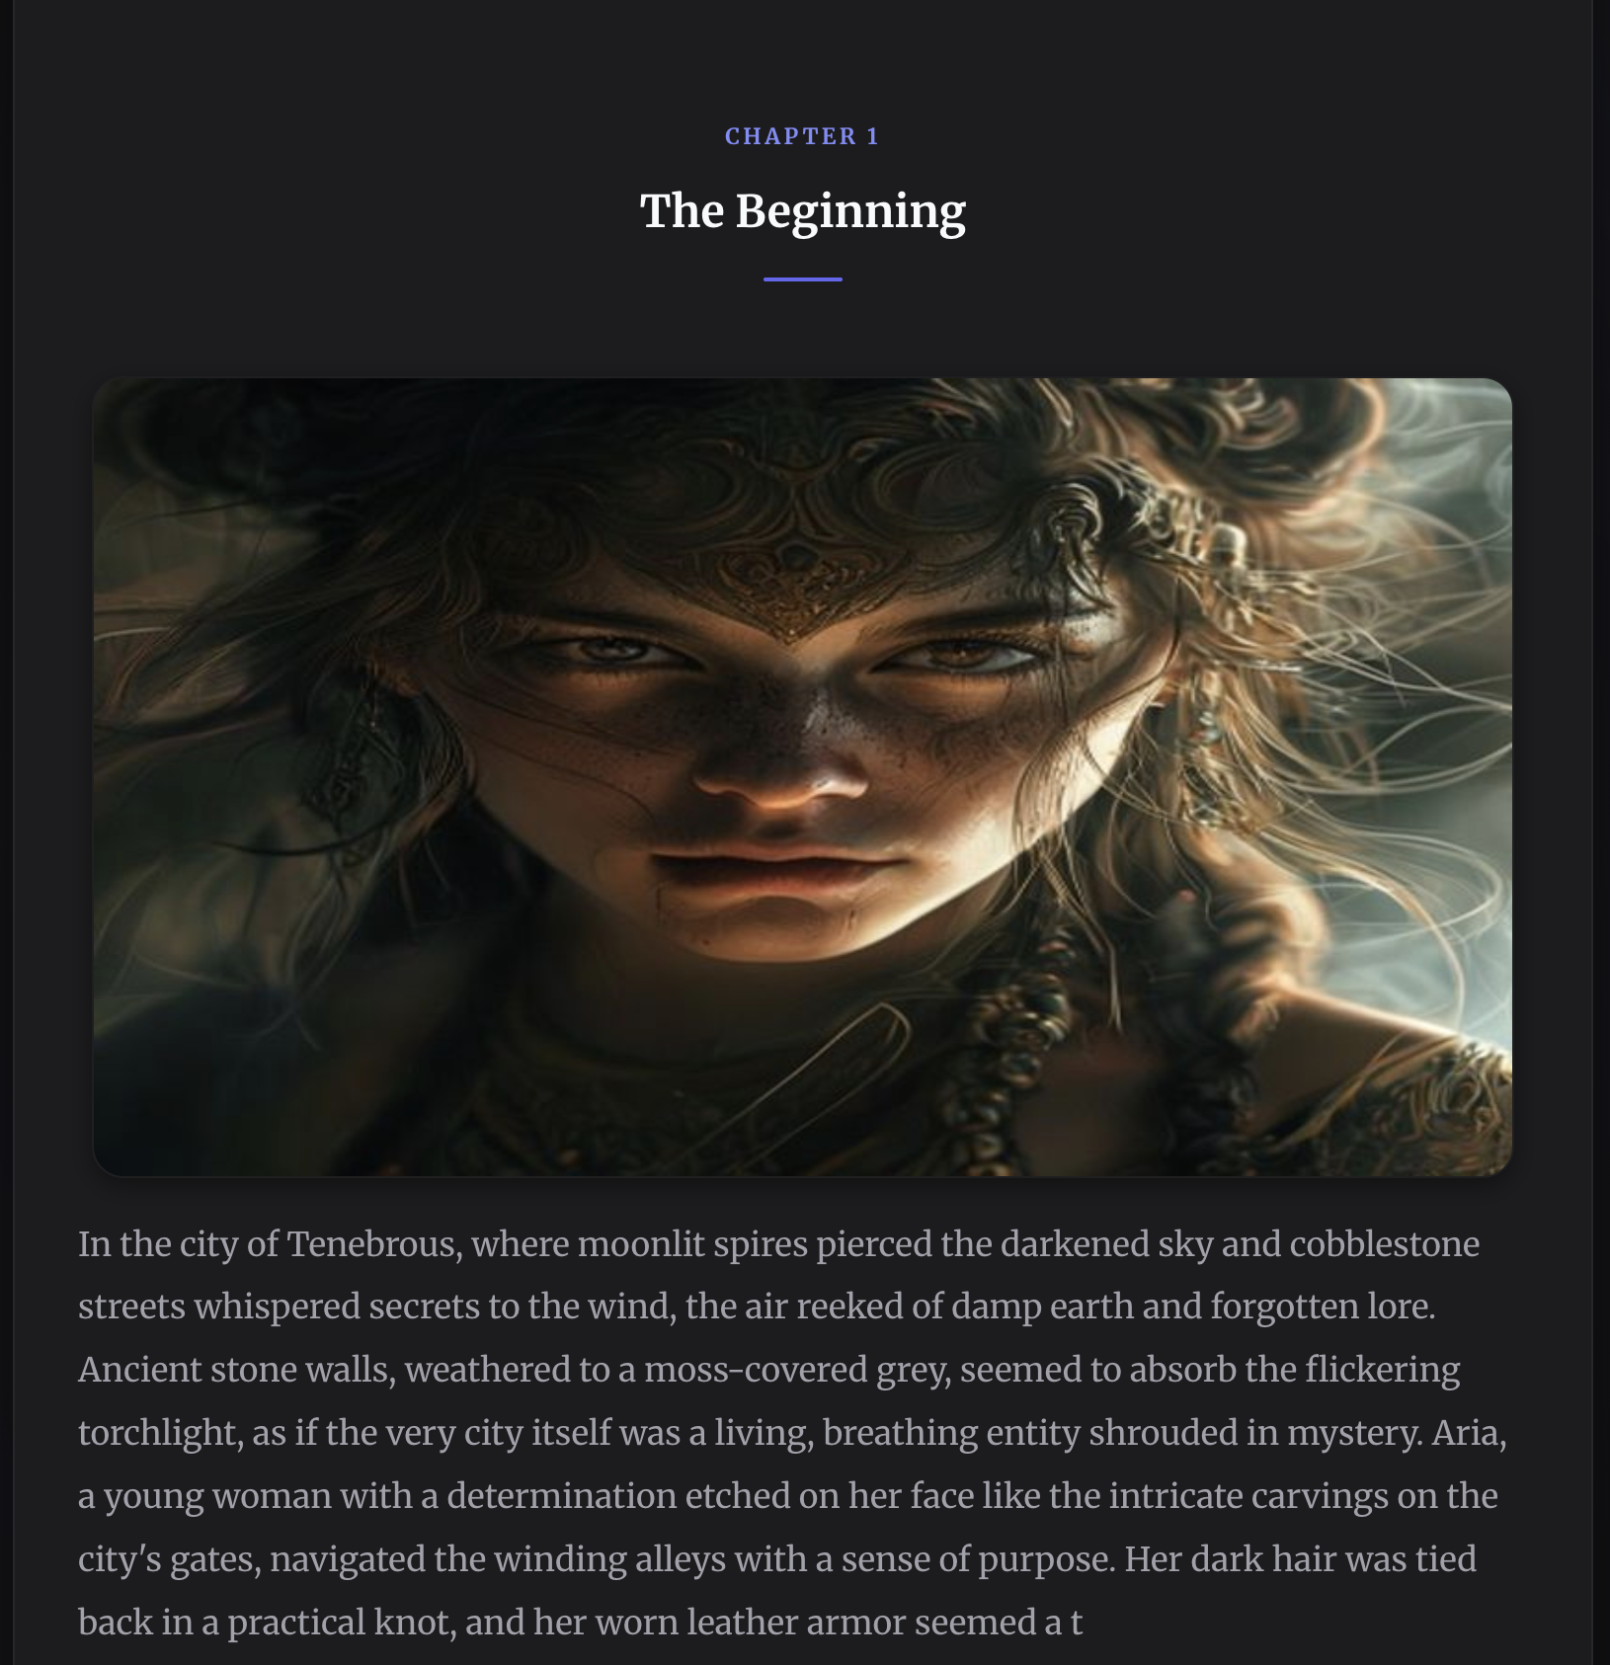
Implementation: Application Screens
Landing page
Question form
Story view
Scene illustration
Choose a budget of 4, 8, 12 or 17 questions
Options, “Write my own” answers, own questions
Opening written by the fine-tuned Llama model
Chapter with its illustration (earlier session)
Also implemented: narration controls, ambient-music toggle, Story Map, Character Graph, TXT / Markdown / HTML export and a settings panel to switch between the fine-tuned and the pretrained Llama model.

Slide 16
Results: Fine-Tuned vs Pretrained Llama
4.58 → 3.30
28% lower
191 of 191
49 of 49
Held-out perplexity (lower is better)
Perplexity on unseen stories
Test samples where fine-tuning helped
Test stories where fine-tuning helped
191 samples from 49 stories that were not used in training. Paired comparison by story: mean loss difference 0.341, Wilcoxon signed-rank p < 0.001.

Slide 17
Results: Generated Stories and User Study
37 tokens/s
10 s
75% → 100%
4.3 / 5
Generation speed, fine-tuned model
Mean time to write one segment
Outputs that are story text only
Overall satisfaction in the user study
Fine-tuned segments are shorter: 275 words on average against 344 for the pretrained model.
The user study (15 participants, 30 stories) was carried out with the pretrained Llama 3.1 8B model, before the fine-tuned model was available; its ratings describe the framework.

Slide 18
Conclusion
This project presents an interactive question-and-answer-based story generation system that uses the capabilities of large language models to create coherent, personalized, and context-rich narratives. By capturing structured user inputs and converting them into meaningful story attributes, the system demonstrates how generative AI can enhance creativity, engagement, and customization in textual storytelling. The proposed framework improves narrative coherence, strengthens personalization, and enables controlled story generation, addressing key limitations found in traditional prompt-based systems. Overall, the work highlights the potential of LLMs to transform user-driven inputs into high-quality stories with improved consistency and relevance.
Conclusion

Slide 19
References
[1] A. Vaswani et al., “Attention is all you need,” NeurIPS, 2017.
[2] H. Touvron et al., “LLaMA: Open and efficient foundation language models,” arXiv:2302.13971, 2023.
[3] Meta AI, “Llama 3.2: Revolutionizing edge AI and vision with open, customizable models,” 2024.
[4] E. J. Hu et al., “LoRA: Low-rank adaptation of large language models,” ICLR, 2022.
[5] T. Dettmers et al., “QLoRA: Efficient finetuning of quantized LLMs,” NeurIPS, 2023.
[6] A. Hannun et al., “MLX: Efficient and flexible machine learning on Apple silicon,” 2023.
[7] F. Khan, “Thousand stories, hundred genres,” Hugging Face dataset, 2023.
[8] A. Fan, M. Lewis and Y. Dauphin, “Hierarchical neural story generation,” ACL, 2018.
[9] P. Mirowski et al., “Co-writing screenplays and theatre scripts with language models,” CHI, 2023.
[10] A. Yuan et al., “Wordcraft: Story writing with large language models,” IUI, 2022.
[11] R. Rombach et al., “High-resolution image synthesis with latent diffusion models,” CVPR, 2022.
[12] G. Freytag, Technique of the Drama, 1900 (English translation).

Slide 20

Thank You
Anjali Madan Jha

